Slide 1
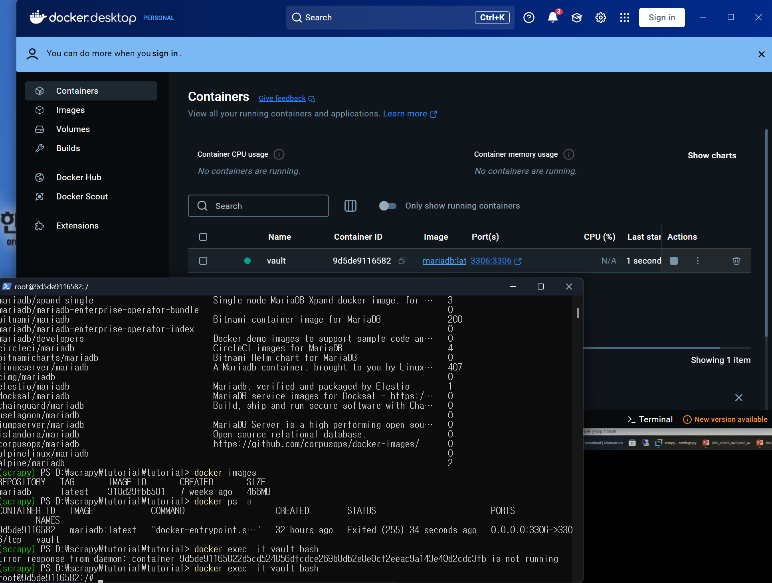
cd D:
cd scrapy
./Scripts/Activate.ps1
cd tutorial
cd tutorial
Docker search mariadb – docker 실행 후 활성화
Docker exec –it –valut bash – 도커에서 마리아 Actions 후에 실행해야 함
Apt update
Apt upgrade –y
Apt install nano
Nano /etc/mysql/my.cnf
컨트롤x하면 나와짐.
Docker restart vault
Docker ps –a
Docker exec –it vault bash
Mariadb –u root –p : 마리아 디비로 접속
비번 : bigdata+
Quit 하면 종료
Crawler 접속 및 비밀번호
Docker exec –it crawler bash
Crawler+
Show databases;
Activate.ps1으로 가상환경 설정 후 tutorial로 들어감

Slide 2
Use scrapy;
Show table;
Create table MY_TEST( ID int primary key, NAME varchar(20))
Insert into MY_TEST values(1, ‘hello’)
Insert into MY_TEST values(2, ‘world’)
docker run -p 3306:3306 --detach --name vault -e MARIADB_USER=bigdata - e MARIADB_PASSWORD=bigdata+ -e MARIADB_DATABASE=webscrap -e MARIADB_ROOT_PASSWORD=bigdata+ mariadb:latest
Cd D:
Cd ./Scripts/Activate.ps1
cd tutorial
Cd tutorial
Millennium falcon
테이블 만ㄷ름
데이터 넣기

Slide 3
Quotes_spider – Advanced Scrapy
테이블 만ㄷ름
데이터 넣기

Slide 4
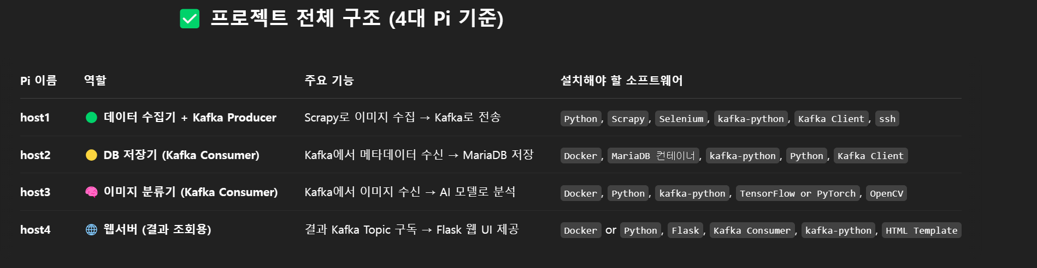
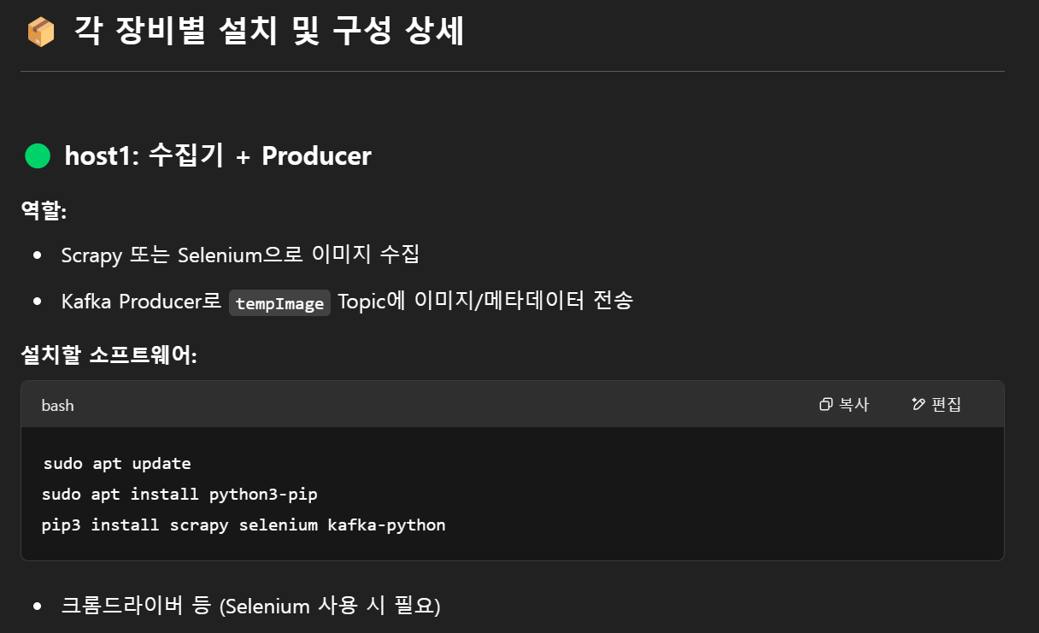

Slide 5
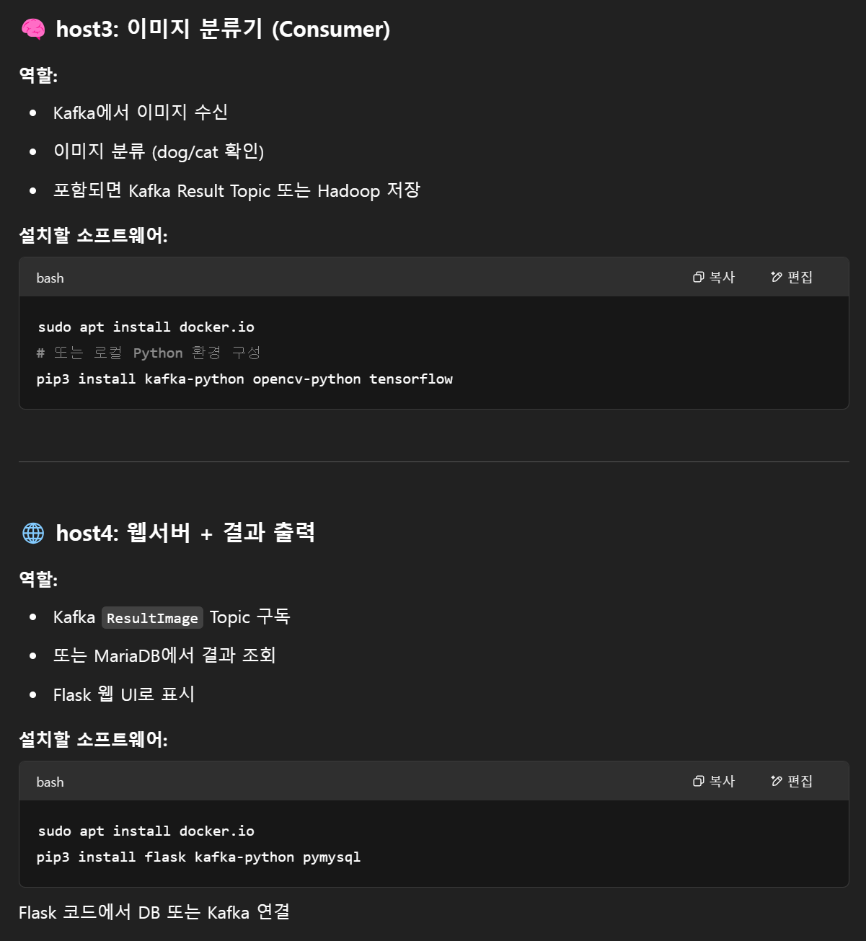
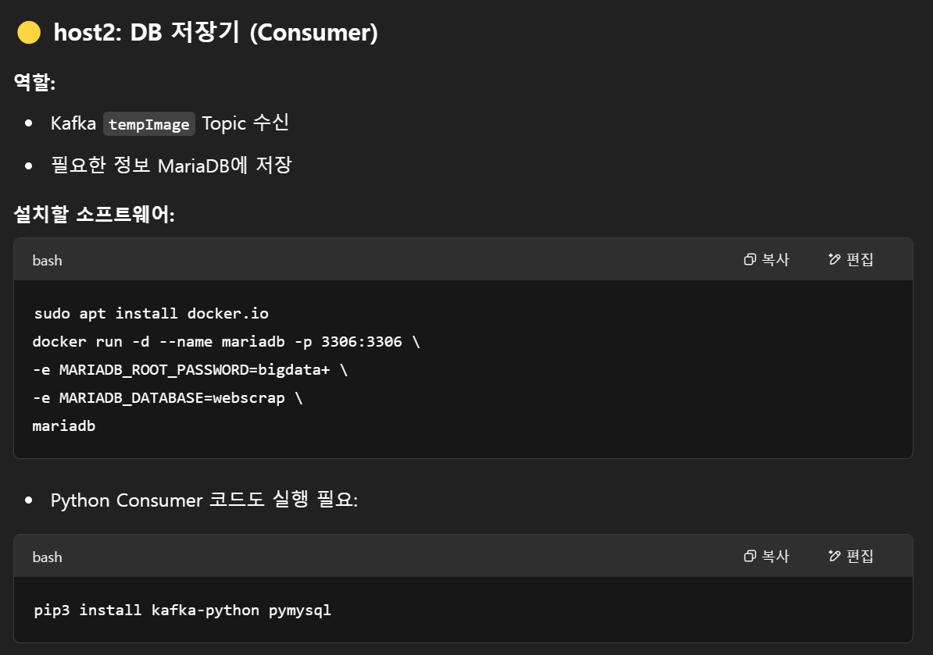

Slide 6
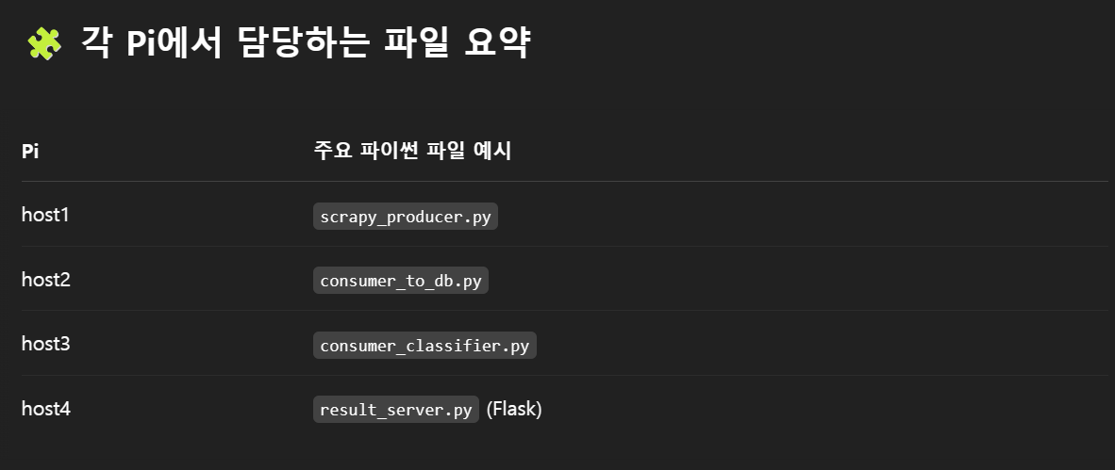
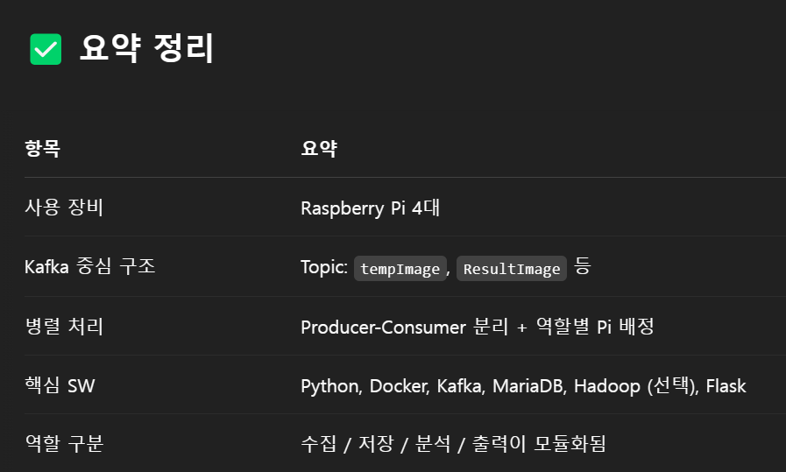
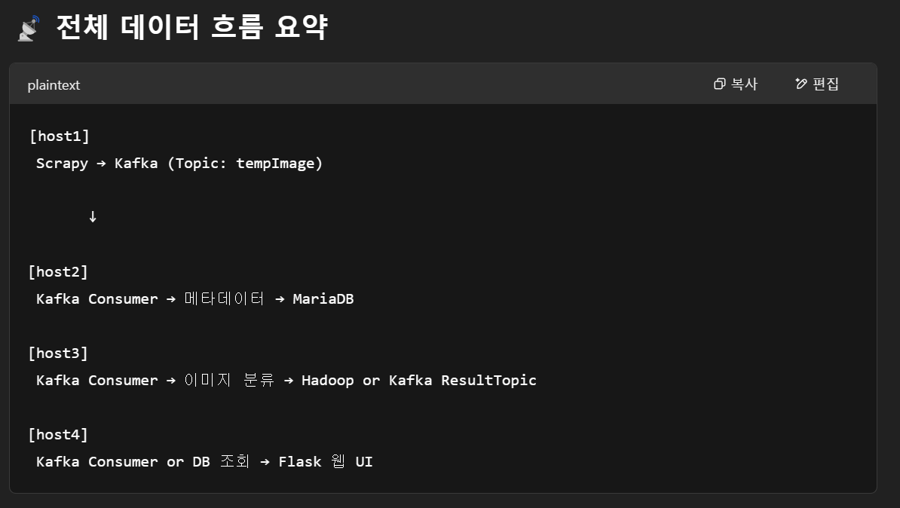

Slide 7
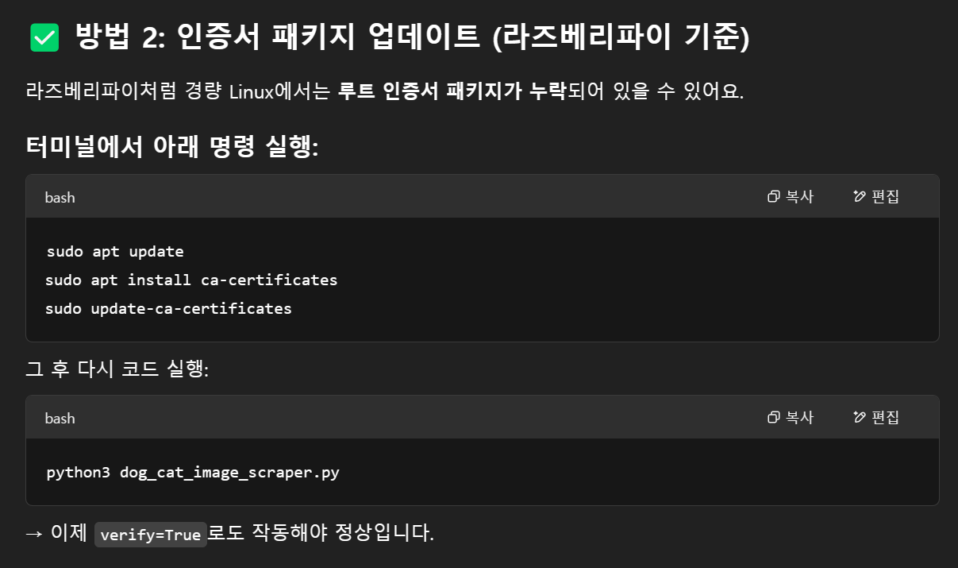

Slide 8
project/
├images/ # scrapy images
├static
│ └ classified_images/ # classified images save
│ └ dog, cat folder
├ image_consumer.py # Kafka Consumer + classification + save DB
├ flask_app.py # Flask webserver
├ templates/
│ └ gallery.html # result hompage

Slide 9
Raspherry Pi. SSL certificate
Run docker desktop
pip install requests pillow beautifulsoup4
Pip install kafka-python
Run Zookeeper
Bash:
docker run -d --name zookeeper -p 2181:2181 zookeeper
- After type, check [docker ps]
Create Wurstmeister/Kafka container
Bash:
docker run -d --name kafka -p 9092:9092 -e KAFKA_ZOOKEEPER_CONNECT=zookeeper:2181 -e KAFKA_ADVERTISED_LISTENERS=PLAINTEXT://localhost:9092 -e KAFKA_LISTENER_SECURITY_PROTOCOL_MAP=PLAINTEXT:PLAINTEXT --link zookeeper wurstmeister/kafka
-- when Kafa + zookeeper haver same docker network.
Bash:
docker run -d --name kafka -p 9092:9092 -e KAFKA_ZOOKEEPER_CONNECT=zookeeper:2181 -e KAFKA_ADVERTISED_LISTENERS=PLAINTEXT://192.168.0.102:9092 -e KAFKA_LISTENERS=PLAINTEXT://0.0.0.0:9092 -e KAFKA_LISTENER_SECURITY_PROTOCOL_MAP=PLAINTEXT:PLAINTEXT --link zookeeper wurstmeister/kafka

Slide 10
Raspherry Pi. SSL certificate
Run docker desktop
pip install requests pillow beautifulsoup4
Pip install kafka-python
Docker delete
Bash : docker rm kafka
Create MariaDB
Bash:
Busan : docker container name. Docker ps [name] = busan
docker run -p 3306:3306 --detach --name vault -e MARIADB_USER=bigdata -e MARIADB_PASSWORD=bigdata+ -e MARIADB_DATABASE=webscrap -e MARIADB_ROOT_PASSWORD=bigdata+ mariadb:latest
: docker container’s name : vault.
Bash: docker ps
-zookeeper / mariadb / kafka should run..
docker run -p 3306:3306 --detach --name vault -e MARIADB_USER=bigdata - e MARIADB_PASSWORD=bigdata+ -e MARIADB_DATABASE=webscrap -e MARIADB_ROOT_PASSWORD=bigdata+ mariadb:latest

Slide 11
Raspherry Pi. SSL certificate
Run docker desktop
pip install requests pillow beautifulsoup4 kafka-python
Docker delete
Bash : docker rm kafka
Create MariaDB
Bash:
Busan : docker container name. Docker ps [name] = busan
docker run -p 3306:3306 --detach --name vault -e MARIADB_USER=bigdata -e MARIADB_PASSWORD=bigdata+ -e MARIADB_DATABASE=webscrap -e MARIADB_ROOT_PASSWORD=bigdata+ mariadb:latest
: docker container’s name : vault.
Bash: docker ps
-zookeeper / mariadb / kafka should run..
docker run -p 3306:3306 --detach --name vault -e MARIADB_USER=bigdata - e MARIADB_PASSWORD=bigdata+ -e MARIADB_DATABASE=webscrap -e MARIADB_ROOT_PASSWORD=bigdata+ mariadb:latest

Slide 12
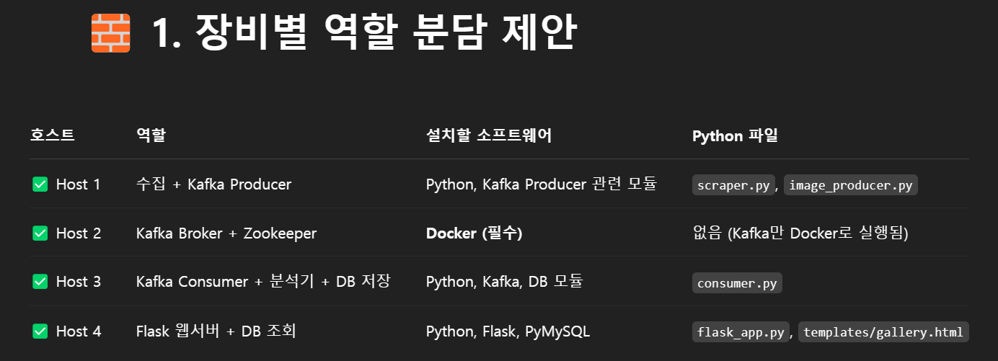
docker run -p 3306:3306 --detach --name vault -e MARIADB_USER=bigdata - e MARIADB_PASSWORD=bigdata+ -e MARIADB_DATABASE=webscrap -e MARIADB_ROOT_PASSWORD=bigdata+ mariadb:latest

Slide 13
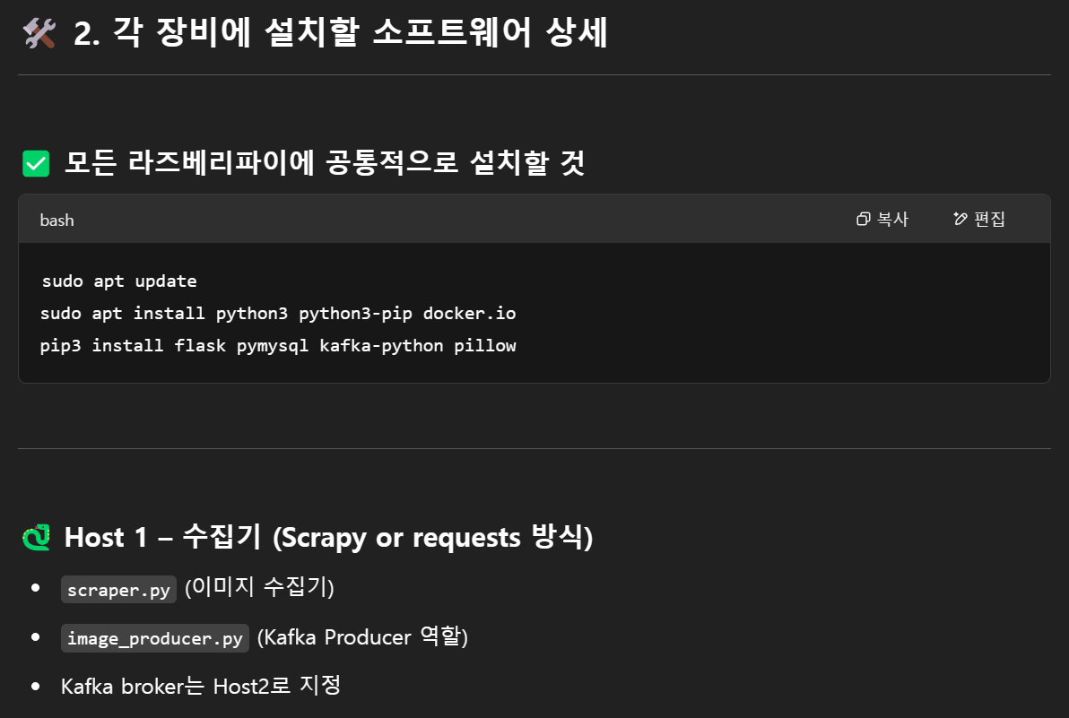
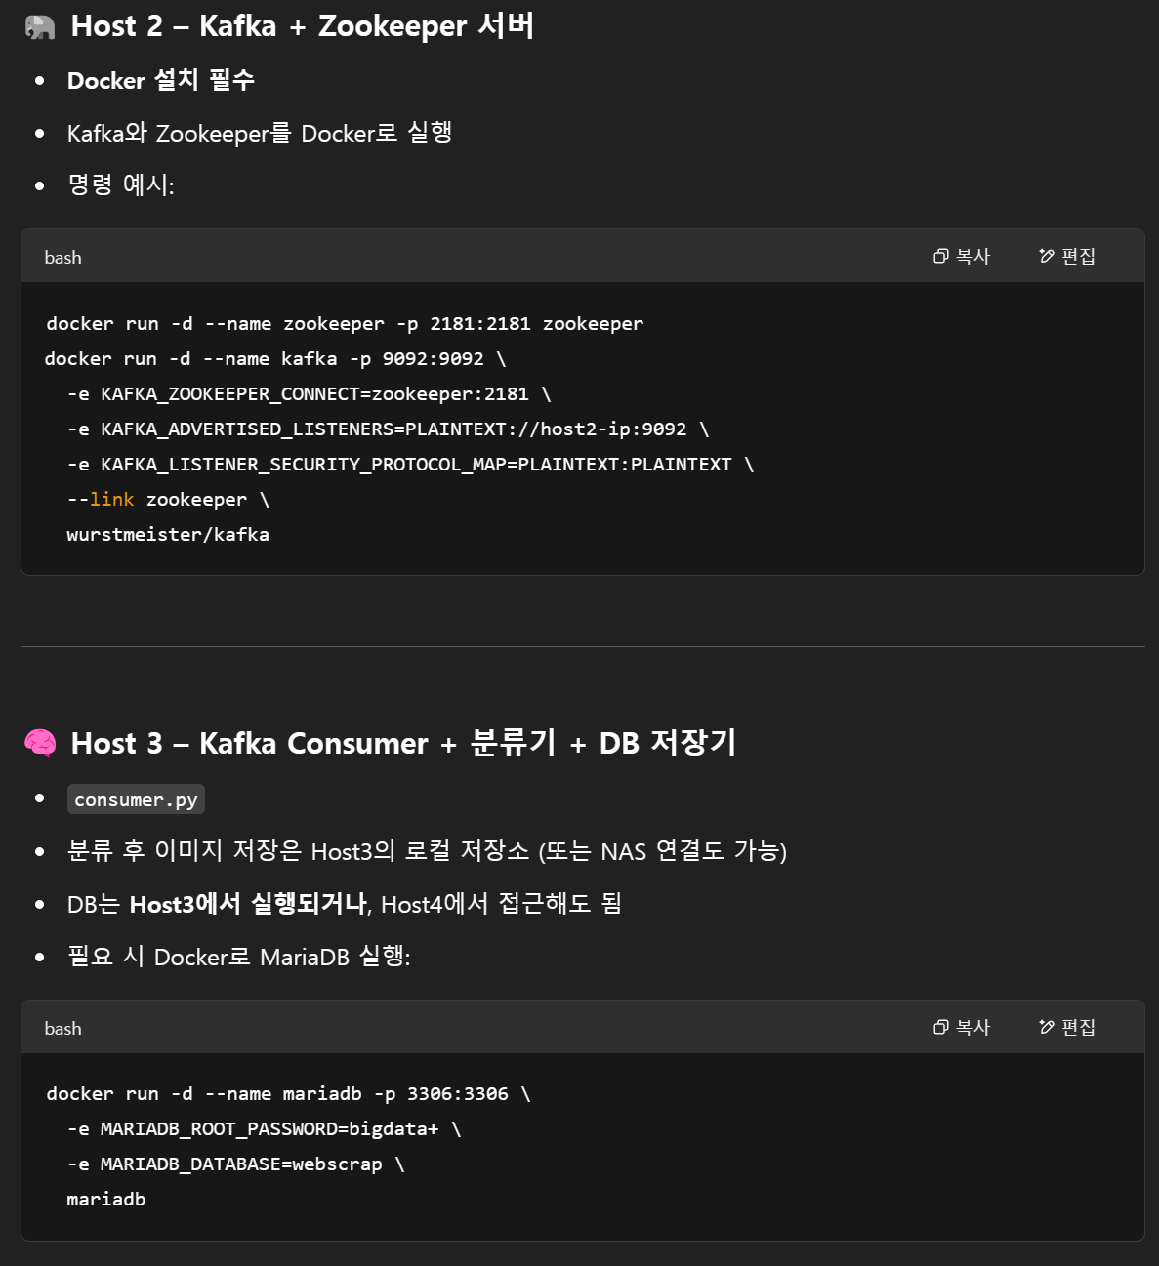

Slide 14
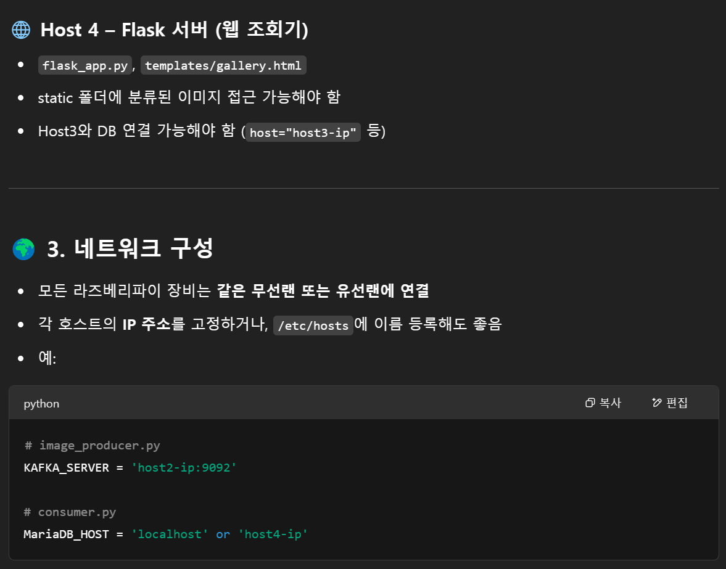
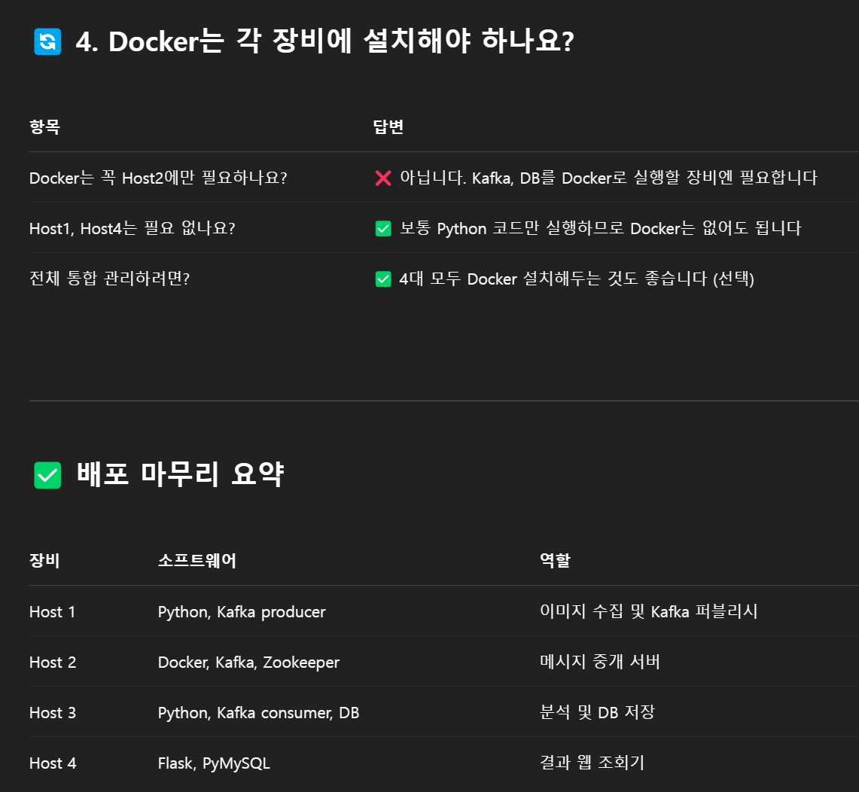

Slide 15
라즈베리파이용 경량화 AI
pip install tflite-runtime kafka-python pymysql pillow

